Slide 1
Booking System of Pet Stores
Kwan Wai Kiu 21023942A 201A
Wan Hoi Nam 21030030A 201A
Ng Kwan Ho 21090099A 201B
Chan Yi Chun 21027283A 201B
Chan Lap Hang 21017486A 201A
* Wong Hiu Chun 21137816A 201A

Slide 2
Contents
01
02
03
04
Introduction
Requirement Analysis
Appendix
Process Development

Slide 3
01
Introduction

Slide 4
Project Background
Shop Name:
Care Pet Hotel (A large chain store for pet)
Shop Information:
Main store (Kowloon) : Beauty (redevelopment), Homestay (redevelopment), Cafe, Sports (indoor swimming pool/sports field) (new expansion)
Side shop: beauty service shop x5, pet coffee shop x2

Slide 5
Objective
provides an approach to build connection with client
Project aim: introduce services and recreation in company and enhance the relationship of people and pet
Due to the expansion and reconstruction of hotel facilities and addition of membership services, a new webpage needs to be redesigned

Slide 6
02
Requirement Analysis

Slide 7


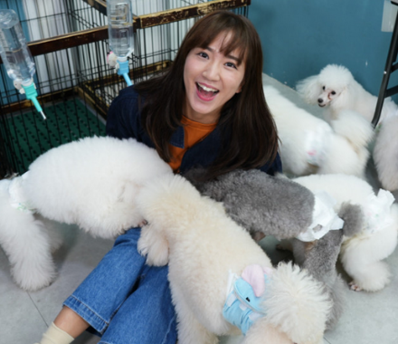


Target user with Persona
Pet Trainer
Name: Hugo Lam
Background Age: 25 Family: Single Residence: Kowloon Gender: Male | Goal Give a support to pet owners for training the behavour of pet Education of pet owners on building relationship with pets | How To Solve Better management of booking system
Identifier External / Internal Quiet / Proactive Irresponsible / Responsible Careful / Careless | Challenge Balance of demand and quality of service A hygienic and safe environment Equipment maintenance | Objections Cost for purchasing equipment Workload of schedule Training & Education
Pet Owner
Pet Groomers
Name: Ashley Tam
Background Age: 20 Family: Single Residence: Wan Chai Gender: Female | Goal Providing high-quality grooming services Ensuring pet comfort and safety Building relationships with customers | How to Solve Better management of booking system
Identifier External / Internal Quiet / Proactive Irresponsible / Responsible Careful / Careless | Challenge Equipment maintenance Availability of appointments Pets mental health Maintain environment | Objections Cost for purchasing equipment Workload of schedule Training & Education
Pet Store Manager
Name: Patrick Chan
Background Age: 36 Family: Married, have two children Residence: Wan Chai Gender: Male | Goal Provide excellent service Managing inventory and supplies Team management Promote store to attract new customer | How to Solve Use new technique such as take video in YouTube Analyse comment monthly Have recruitment event in semiannual
Identifier External / Internal Quiet / Proactive Irresponsible / Responsible Careful / Careless | Challenge Unknown favor of customer Not enough new customer Insufficient staff for shifting | Objections Customer complaints Staff Performance Competition Inventory management
Pet Store Staff
Name: Jane Lam
Background Age: 30 Family: Married, have two children Residence: Hung Hom Gender: Female | Goal Offer high – quality service to the client and pet Provide a place for customer and pet to build relationship | How to Solve Continuous education and training for knowledge of pets Provide clear information for event and service
Identifier External / Internal Quiet / Proactive Irresponsible / Responsible Careful / Careless | Challenge not enough knowledge of pet Ineffective marketing skill May not have enough understanding of event and service | Objections Lack of training for using system Work condition
Pet Store Staff
Pet Owner
Name: John Doe
Background Age: 45 Family: Married, have one child Residence: Kowloon Tong Gender: Male | Goal Provide high-quality care for pets building relationship with pets | How to Solve Provide information for how to care pet Provide more timeslot for booking service
Identifier External / Internal Quiet / Proactive Irresponsible / Responsible Careful / Careless | Challenge Insufficient time to take care pets Lack of knowledge to take care pets | Objections Price of service Quality of service Knowledge of staffs
Pet Store Manager
Pet Groomer
Pet Trainer

Slide 8

Method for Analysis
Direct Observation
Observe the behavior of target audience
Get insight from their task
Indirect Observation
Observe the behavior / requirement by reviewing their work document (report & statistic)
A direct observation and indirect observation are used as an approach for getting the user stories and requirement.
Direct observation
Observe the behavior of target audience and get insight from their task
Indirect Observation
Observe the behavior / requirement by reviewing their work document (report & statistic)

Slide 9
Major Functional Requirement
Customer Side:
Navigation Menu
Session: Navigation Menu | Priority: High | No. #1
User stories: As a customer I want to have an overview of the component of website So that I can access anywhere in website depend on my demand
Scenario: Given customer want to have more information on service after visiting homepage When a customer visit the homepage and want to navigate service webpage Then I can access the service webpage by press the URL
Functional Requirement: A consistent layout across all pages Redirection URL for possible webpage High contrast color for a readable navigation
Non-functional Requirement: Speed: The redirection of URL must response within 4000ms.
Session: Event | Priority: Medium | No. #3
User stories: As a customer I want to know what event that pet hotel provided. So that I can have better understanding what event provided and make appointment easier
Scenario: Given a customer have interest what event that our company provided When the customer visits “event” webpage and browse the information Then customer can have better overview on our event and make appointment easier
Functional Requirement: The website should have a clear list to show all the categories of events offered The website should provide various block to show the information The website should provide a “know more” button to provide more detailed information The website should provide a “next” button to look for other events
Non-functional Requirement: Speed: The redirection after pressing button must response within 4s. Accurately: The redirection should be accurate to right position
Session: Contact | Priority: Medium | No. #4
User stories: As a customer I want to get the locations and contact information of pet hotel So that I can find location and make appointments more easily
Scenario: Given a customer want to visit pet hotel When customer visiting “about” page and click embedded google map Then customer could find a location and contact to our company
Functional Requirement: The website should provide contact information of Pet Hotel The website should provide embedded google map with location The website should provide the branch of pet hotel with con
Non-functional Requirement: Accurately: The website should provide accurate information about the contact. Usability: Embedded google map should be zoom in and zoom out to find the location
Session: Comment | Priority: Low | No. #5
User stories: As a customer I want to see comments from other customers So that I can make decision on whether using the pet hotel services
Scenario: Given I am interested in knowing about other perspective from the customer When I visit the comment session and browse the comment of another user Then I can make a decision whether having the service of pet hotel
Functional Requirement: The website should provide the username of customer who left the comment The website should show the content of customer who left the comment Should provide a “>” and “<” button so that user can watch other comments
Non-functional Requirement: Speed: The respond time for switching comments should be less than 500ms Accurately: The redirection should be accurate to next comment
Session: Service | Priority: Medium | No. #2
User stories: As a customer I want to know what service that pet hotel provided. So that I can have better understanding what service provided and make appointment easier
Scenario: Given a customer have interest what service that our company provided When the customer visits the service webpage and browse the information Then customer can have better overview on our service and make appointment easier
Functional Requirement: The website should have a clear list to show all the categories of services offered The website should provide various block to show the information The website should provide a “learn more” button to provide more detailed information The website should provide a “next” button to look for other services
Non-functional Requirement: Speed: The redirection after pressing button must response within 4s. Accurately: The redirection should be accurate to right position
Service
Event
Contact
Comment

Slide 10
Major Functional Requirement
Booking System:
Session: Payment | Priority: High | No. #9
User stories: As a customer I want to finish the booking and have payment online So that I can complete booking effectively
Scenario: Given customer is making a booking on the website have booked an appointment When customer want to have payment and enter payment information Then customer can complete the booking with payment
Functional requirement: A various payment method with the redirection of system server respectively The website should display the payment information (username, price, service) in a block The website should provide a button to redirect the previous page for correction The completion of the payment should be less than 3 steps.
Non-functional requirement: Speed: The respond time of payment should be less than 5000ms Accurately: The redirection of payment should be accurate. Security: The personal information should not be exposed and encrypted
Session: Sign In | Priority: High | No. #7
User stories: As a customer I want to login to the website So that I can access more information on booking service
Scenario: Given a customer have registered to the website When I visit the website and login with the username and password Then I can successfully access to my account to access all function of the website
Functional requirement: The website should have two text field for inputting the value of username and password The website should have button for login the account The text field of username and password can not be empty
Non-functional requirement: Speed: the respond time of login should be less than 1000 ms. Security: Can successfully login when user input correct username and password
Session: Booking | Priority: High | No. #8
User stories: As a customer I want to book an appointment at the pet hotel So that I can easily find the available services to schedule my appointment
Scenario: Given customer want to book an appointment at the pet hotel When customer visit the booking page and have booking Then customer can schedule my appointment without difficulty
Functional requirement: The website should provide different session to show all the categories of events offered The website should show the information of booking The website should provide a “Back” button for the redirection of previous page The website should provide a “Next” button for the direction of next page
Non-functional requirement: Speed: The redirection after pressing button must response within 4000ms. Accurately: The redirection should be accurate to right position
Session: Sign Up | Priority: Low | No. #6
User stories: As a customer I want to sign up an account So that I can access more information on booking service
Scenario: Given a customer did not register to the website When I visit the website and sign in an account with the username and password Then I can successfully access to login the system and access all function of the website
Functional requirement: The website should have two text field for inputting the value of username and password The website should have button for login the account The text field of username and password cannot be empty
Non-functional requirement: Speed: the respond time of login should be less than 1000 ms. Security: The
Sign Up
Sign In
Booking
Payment

Slide 11
Non - Functional Requirement
Speed
The redirection of URL must response within 4000ms.
The respond time of payment should be less than 5000ms
The respond time for swathing comments should be less than 500ms
Usability
Embedded google map should be zoom in and zoom out to find the location
Accurately
The redirection should be accurate to right position
Maintainability
The update time of the website should be held once per month
Security
The personal information should not be exposed and encrypted
Speed :
The redirection of URL must response within 4000ms.
The respond time of payment should be less than 5000ms
The respond time for swathing comments should be less than 500ms
Usability:
Embedded google map should be zoom in and zoom out to find the location
Accurately:
The redirection should be accurate to right position
Maintainability:
The update time of the website should be held once per month.
Security:
Ensure the website is secure and protects users’ personal and payment information.
Can successfully login when user input correct username and password

Slide 12
03
Process Development

Slide 13
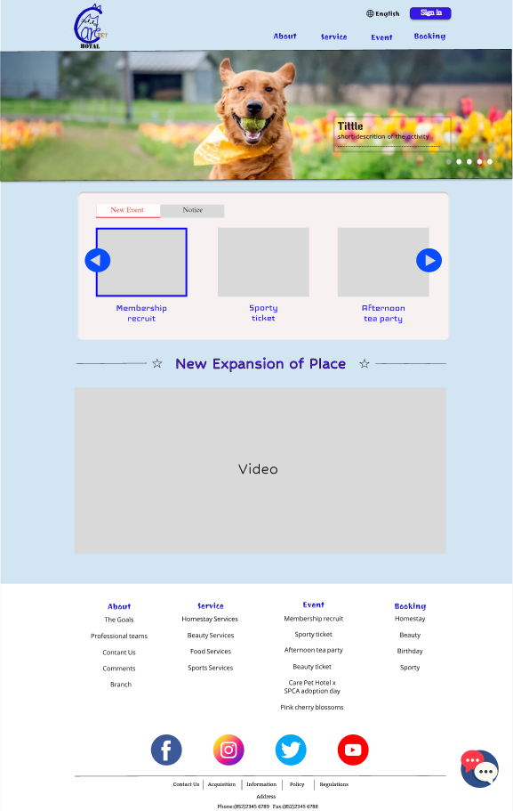
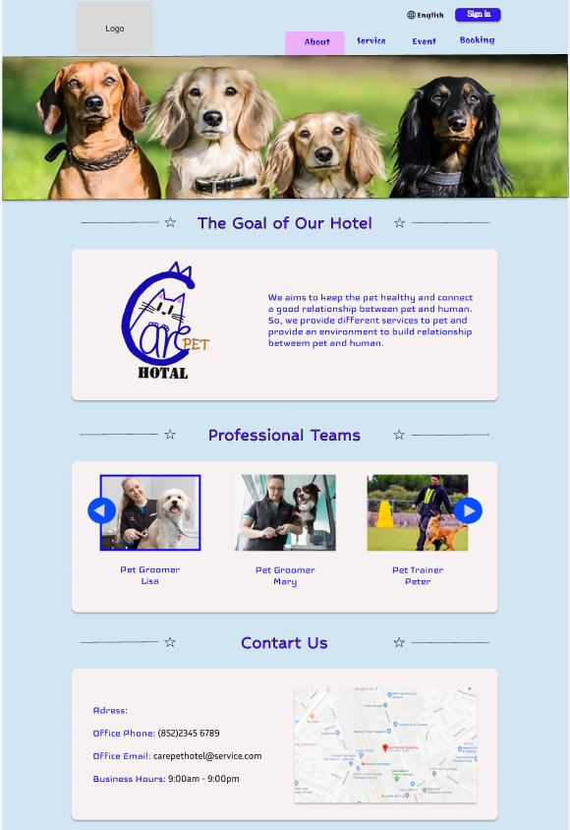
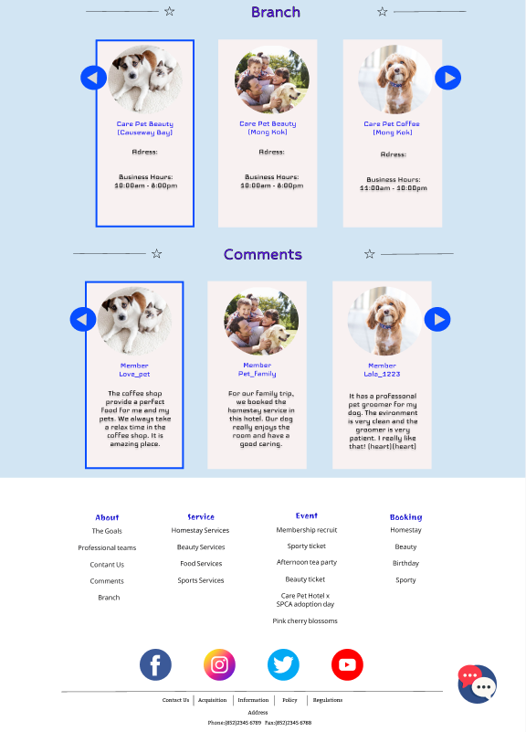
Wireframe
Home Page
About Page
Have a deep understanding of hotel's service and objectives
Provide some contact information for further interaction with client
Allows user to have an overview on hotel's new projects

Slide 14
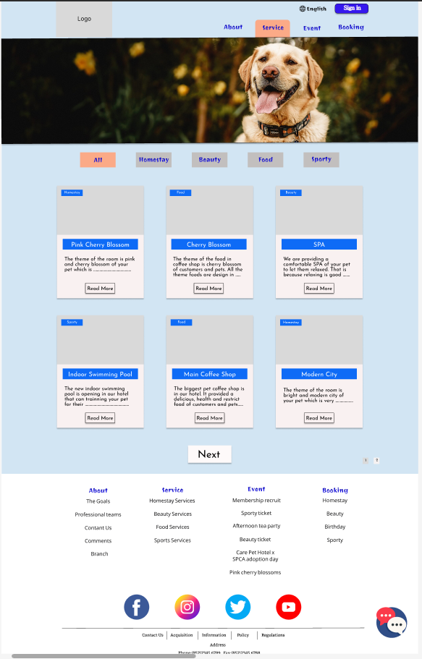
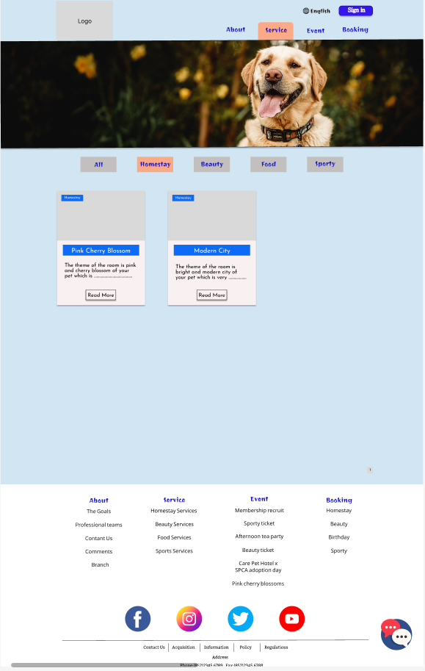
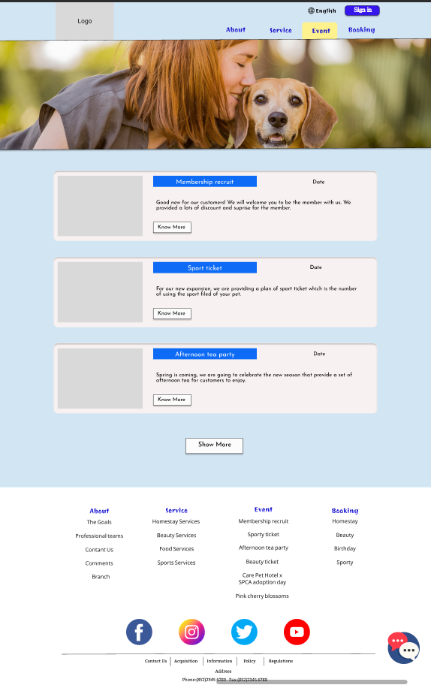
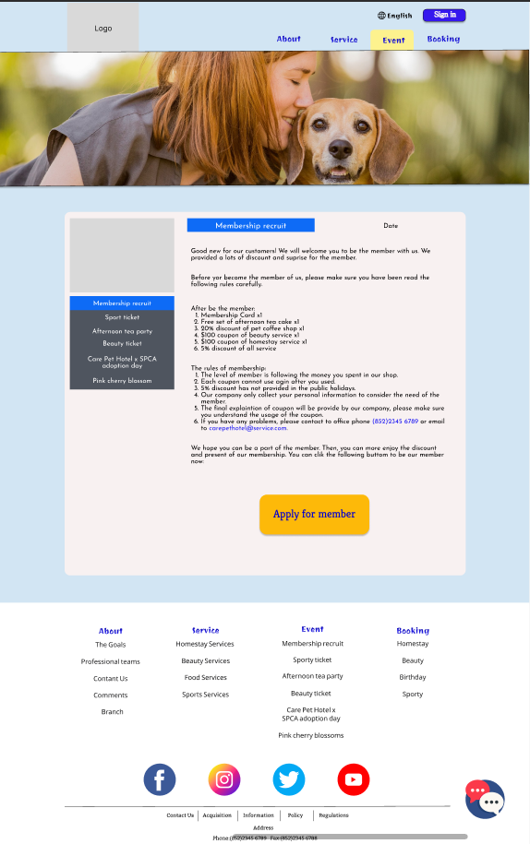
Wireframe
Service Page
Event Page
Understand the details of services that provided by the pet hotel
Navigate and Understand details of project
Give inspiration on the appointment

Slide 15
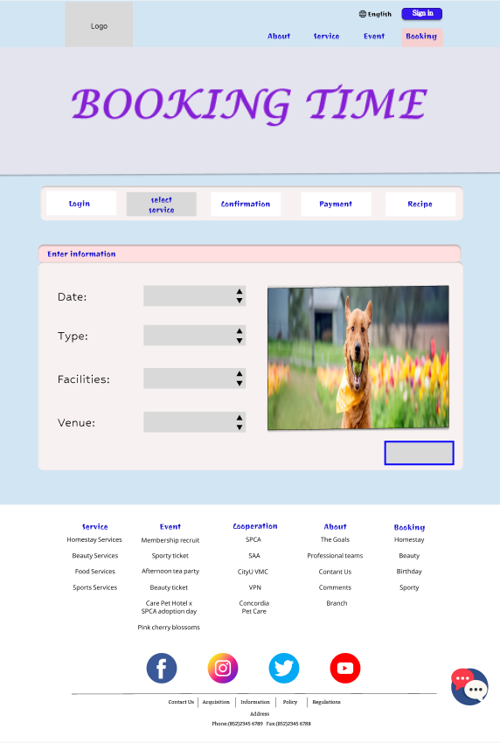
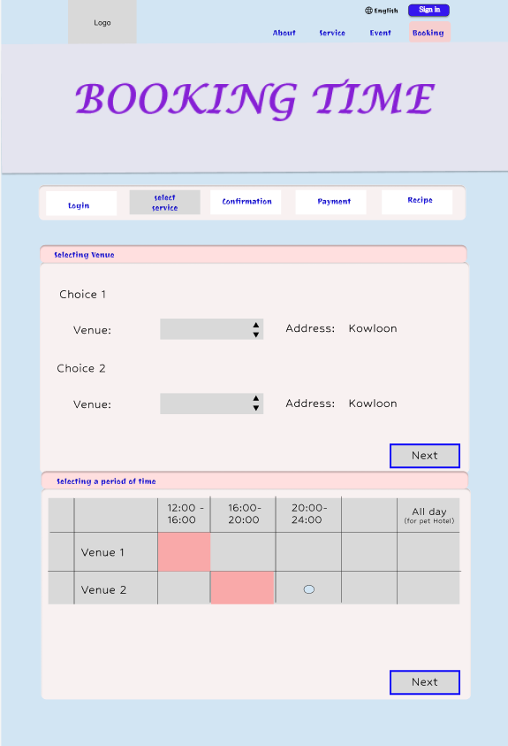
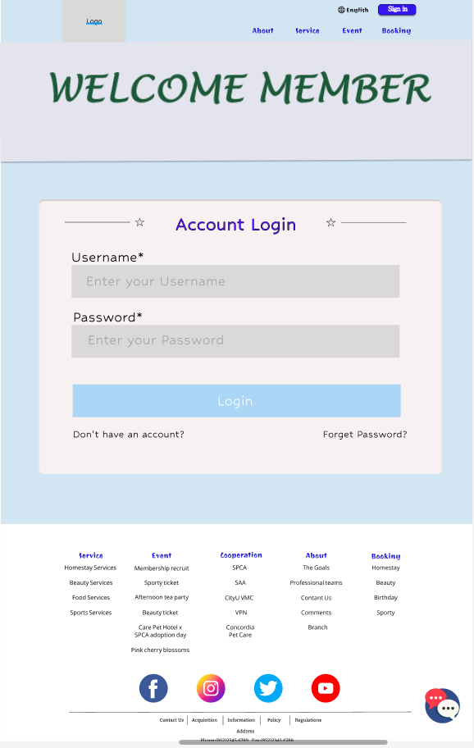
Wireframe
Booking Page
Login Page
Easier for users to choose the right place and time within the service, address, and time provided by pet hotel.
Allow user to login the webpage
Enter account number and login

Slide 16
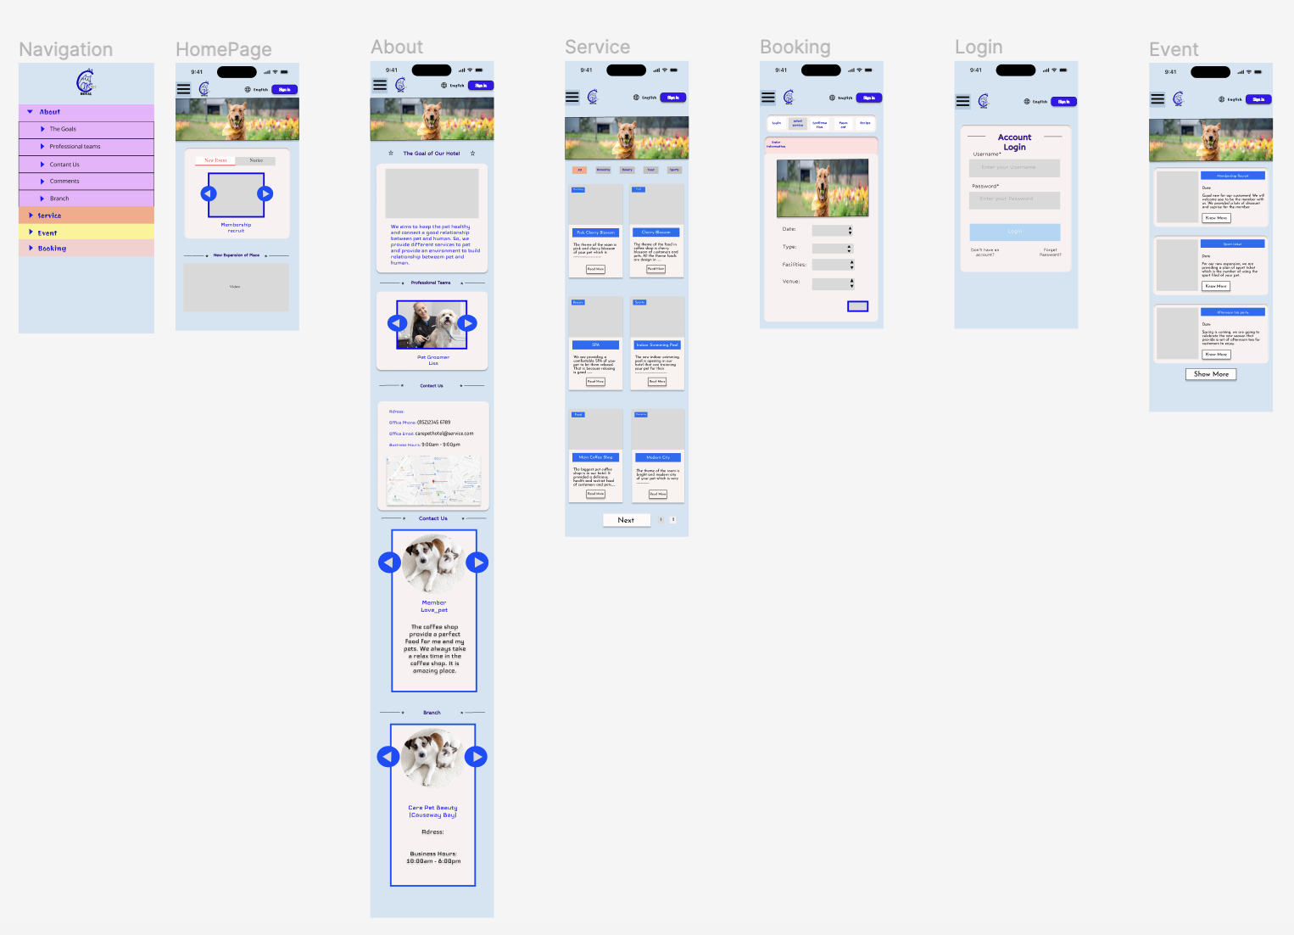
Wireframe
Medium:
It is a High-fidelity wireframe
provides a detailed interface to show the content of webpage
Better communication with programming team without misunderstanding
Mobile Version of Wireframe

Slide 17
Technology Used
HTML
JavaScript
Used for creating web pages
Scripting language that runs in a web browser
Used to structure content on a web page
Creating dynamic and interactive web pages and using Ajax (jQuery)
Defines layout and content of web page
Supports various tags and attributes for creating content
Add animations, form validation, and other interactive features

Slide 18
Technology Used
CSS
Figma
Used for styling and formatting web pages
Create wireframes serve as prototypes
Defines appearance of HTML elements
Show flow of our webpage
Change font styles, background colors, and layout of web page
Offering a wide range of features
functions to simplify development process
Supports various selectors and properties for customizing page styles
Web – based software: easier to collaborate with team members

Slide 19
Use Case
Customer Side:
Navigation Menu
Use Case | Comment, No # 5
Actor | Pet Owner (Primary), Pet Store Staff, Pet Store Manager, Pet Groommer, Pet Trainer
Description | Provide a medium for client to watch comments from other customers and give a help hand to attract the customer
Assumption | Assume the comment of user is collected by the physical store and filtered by the analysis
Steps | User navigate the about page System shows the content of about page User reaches the block of comment and changes by pressing ”<“ and “>” button System display the related comment
Non – functional Requirement | The respond time for swathing comments should be less than 500ms Accurately: The redirection should be accurate to right position
Issues | What information should be showed in webpage? How to prove the authentic of comment? How to present the information?
Use Case | Service, No #2
Actor | Pet Owner (Primary), Pet Store Staff, Pet Store Manager, Pet Groommer, Pet Trainer
Description | Provide a medium for client to navigate the information of service and have booking on our service
Assumption | Assume the content of service is as same as the information of pamphlet in pet hotel
Steps | User navigates the service page System responses by showing the information User presses the button with desire service System responses with the categories of service User press ”Know More” button System responses by showing the related information
Non – functional Requirement | Speed: The redirection after pressing button must response within 4s. Accurately: The redirection should be accurate to right position
Issues | What information should be mentioned in the webpage? How to present the information? How to direct to another page?
Use Case | Event, No #3
Actor | Pet Owner (Primary), Pet Store Staff, Pet Store Manager, Pet Groommer, Pet Trainer
Description | Provide a medium for client to navigate the information of event and have booking on our event
Assumption | Assume the content of event is as same as the information of pamphlet in pet hotel
Steps | User navigates the event page System responses by showing the information User presses the button with desire events System responses with the categories of service User press ”Know More” button System responses by showing the related information
Non – functional Requirement | Speed: The redirection after pressing button must response within 4s. Accurately: The redirection should be accurate to right position
Issues | What information should be mentioned in the webpage? How to present the information? How to direct to another page?
Use Case | Navigation Menu, No #1
Actor | Pet Owner (Primary), Pet Store Staff, Pet Store Manager, Pet Groomer, Pet Trainer
Description | A medium for overview the component of webpage and a faster way for user to navigate the webpage. User can access to different page directly by using menu
Assumption | Assume the redirection of URL is always successful from the webpage
Steps | User press the “Navigation” Button System response by showing the drop down menu
Non – functional Requirement | Speed: The redirection of URL must response within 4s.
Issues | What is the layout of menu? Which page did the menu redirect to? What color should menu use ?
Service
Use Case | Contact, No #4
Actor | Pet Owner
Description | Provide a medium for client to get the information of contact
Assumption | Assume the contact information is most updated and well prepared
Steps | User navigate the about page System shows the content of about page User reaches the block of contact System shows the contact information
Non – functional Requirement | Accurately: The website should provide accurate information about the contact. Usability: Embedded google map should be zoom in and zoom out to find the location
Issues | What information should be provided to the client? How to present the map of the location?
Event
Contact
Comment

Slide 20
Use Case
Booking System:
Sign up
Use Case | Payment, No #9
Actor | Pet Owner
Description | A system for the user to have payment after finished the service booking
Assumption | Assume the payment method is limited and the information of payment should be stated on the interface
Steps | User confirms the information and press ”Next” button System responses payment page and display User enter credit card information System shows the related information User click the “Confirm” button System received and display the “recipe” page
Non – functional Requirement | The respond time of payment should be less than 5000ms The redirection of payment should be accurate
Issues | What information should be stated on the interface? What payment should be used in the system? How to present the information? If the user wants to correct the information, how to correct?
Use Case | Sign In, No #7
Actor | Pet Owner
Description | A login system allow user to login or sign up an account
Assumption | Assume the text field of username and password should not be empty
Steps | User types the username and password System shows the username and password User clicks the “login” button System received and display a message
Non – functional Requirement | Speed: the respond time of login should be less than 1000 ms. Security: The personal information should not be exposed and encrypted
Issues | How to input the username and password? How to login the system after finish input the value?
Use Case | Booking, No #8
Actor | Pet Owner (Primary), Pet Store Staff, Pet Store Manager, Pet Groommer, Pet Trainer
Description | Provide a medium to booking the service and event of pet Hotel
Assumption | Assume the user should login or sign up an account before using booking system.
Steps | User navigates to the booking page. System shows the content of booking page User select desire Date, Type, Facilities, Venue, Time period System shows the related information User press “Next” button System responses by showing the confirmation page
Non – functional Requirement | Speed: The redirection after pressing button must response within 4s. Accurately: The redirection should be accurate to right position
Issues | What session should be provided? What information should ask? How to make the navigation easier? If the user wants to correct the information, how to correct?
Use Case | Sign Up, No #6
Actor | Pet Owner
Description | A login system allow user to login or sign up an account
Assumption | Assume the text field of username and password should not be empty
Steps | User navigates to the login page and click ”Do not have an account?” button System received and redirect to “Sign up” page User types the username, email and password System shows the username, password, email User click “Register” button System received and display a message
Non – functional Requirement | Speed: the respond time of login should be less than 1000 ms. Security: Can successfully login when user input correct username and password
Issues | How to input the username and password? How to login the system after finish input the value?
Sign In
Booking
Payment

Slide 21
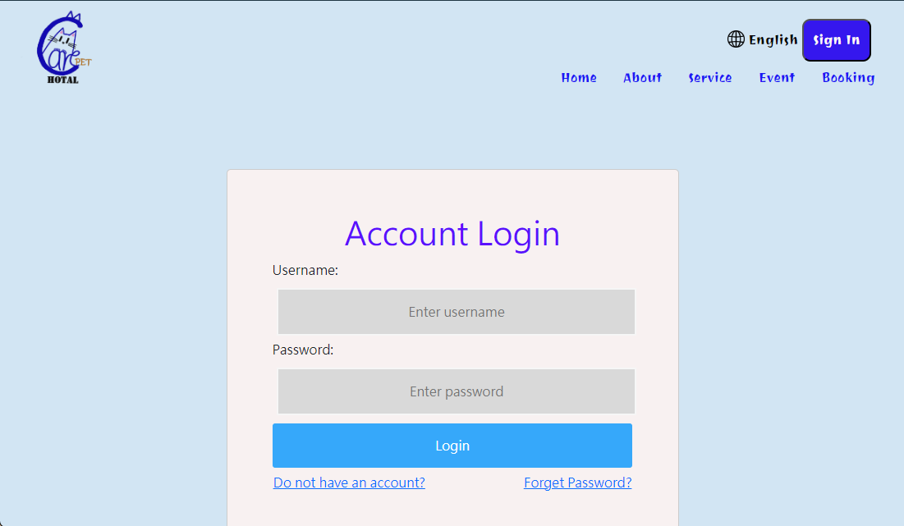
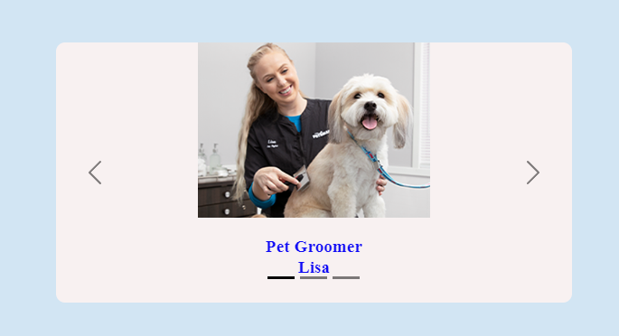
Prototype
Familiar Design
Similar color tone
Maintain consistency of the webpage
Control of carousel make user feel familiar to another website
Less learning time

Slide 22
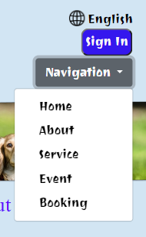
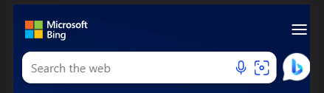
Prototype
Navigation Menu
Navigation Menu on right are similar to other popular website
Similar design to popular website

Slide 23

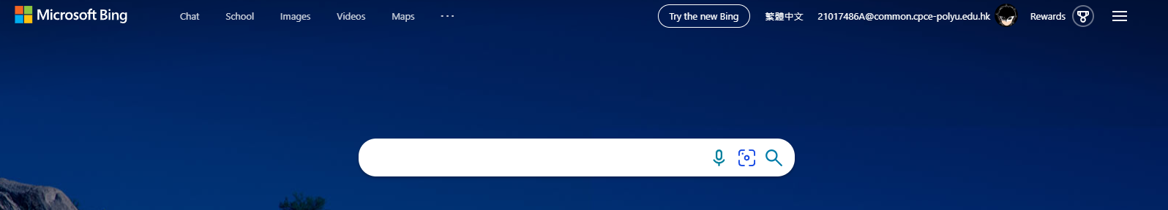
Prototype
Similar Design
Similar design to popular website

Slide 24
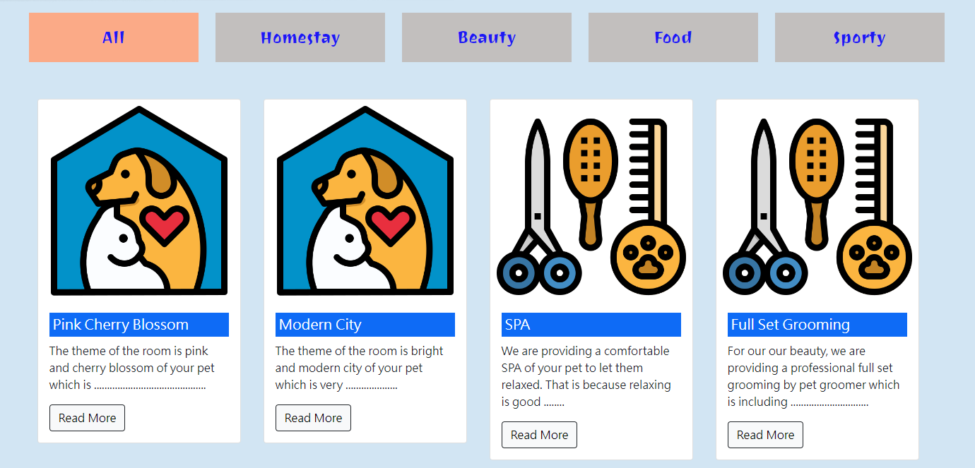
Prototype
Tab Menu
Simple tab menu for easy sorting to user

Slide 25
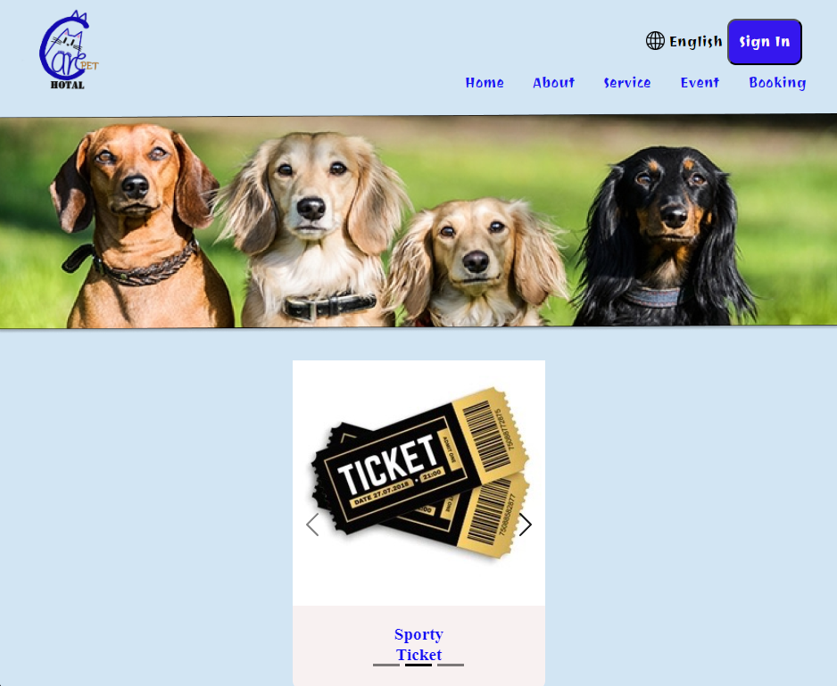
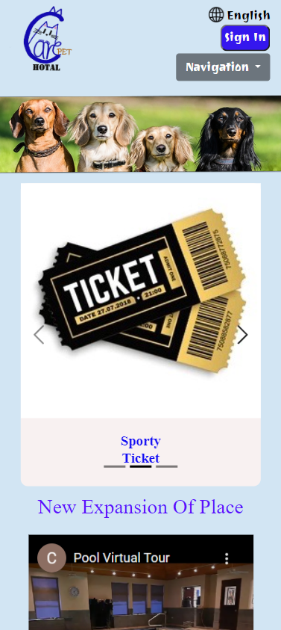
Prototype
Responsive Web Design
Desktop and Tablet version
Mobile Version

Slide 26
04
Appendix

Slide 27
Timeline
Appendix
Work Allocation
Video: https://www.carriagehillkennels.com/indoor-dog-swimming-pool
Photo: https://www.flaticon.com/
Use Case Template: http://www.engr.sjsu.edu/fayad/current.courses/cmpe135-fall03/docs/2-UC-Template-Ex.pdf
Member | Work Allocation
Anthony | Prototyping, Requirement Analysis
Ada | Wireframe Design, Prototyping
Elvis | Requirement Analysis, Process Development
Jacky | Group Leader, Prototyping
Gino | Requirement Analysis, Process Development
Natalie | Wireframe Design, Proofreading
21/3/2023
26/3/2023
Research & Meeting 1
Meeting 2 & Inspiration PPT
Meeting 3 & Wireframe Design
2/4/2023
Meeting 4 & Prototype
10/4/2023
Finish PPT & Modification
12 - 16/4/2023
17 or 25/4/2023
Presentation

Slide 28

Thank You!!!

